Slide 1
Projection
Part Two - Perspective Projection
textbook 5.5-5.7

Slide 2
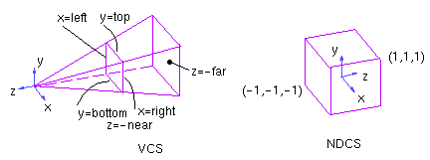
Perspective Projection

Slide 3

Frustrum Matrix
A = (right+left)/(right-left)
B = (top+bottom)/(top-bottom)
C = -(far+near)/(far-near)
D = -2*far*near/(far-near)
E = 2 * near/(right-left)
F = 2 * near/(top-bottom)

Slide 4
Example 1
For example, if we set
left = -1 right = 1
bottom = -1 top = 1
near = 1 far = 4
we get the matrix
┌ 1 0 0 0 ┐
│ 0 1 0 0 │
│ 0 0 -5/3 -8/3 │
└ 0 0 -1 0 ┘

Slide 5
Example 1 continued
So the point
A = [.5, .5, -1.5, 1]
transforms to the point A'
┌ 1 0 0 0 ┐ ┌ .5 ┐ ┌ .5 ┐
│ 0 1 0 0 │ * │ .5 │ = │ .5 │
│ 0 0 -5/3 -8/3│ │-1.5│ │-.166│
└ 0 0 -1 0 ┘ └ 1 ┘ └ 1.5 ┘
to find the NDC of A, divide A' by w
A'' = [.33, .33, -.111, 1]

Slide 6
Example 1 continued
So the point
B = [.5, .5, -3.5, 1]
transforms to the point B'
┌ 1 0 0 0 ┐ ┌ .5 ┐ ┌ .5 ┐
│ 0 1 0 0 │ * │ .5 │ = │ .5 │
│ 0 0 -5/3 -8/3│ │-3.5│ │3.166│
└ 0 0 -1 0 ┘ └ 1 ┘ └ 3.5 ┘
to find the NDC of B divide B' by w
B'' = [.14, .14, .903, 1]

Slide 7
Example 1 finally
So …
A = [.5, .5, -1.5, 1]
A'' = [.33, .33, -.111, 1]
And
B = [.5, .5, -3.5, 1]
B'' = [.14, .14, .903, 1]

Slide 8
Example 2
Let's push the box far away from the origin:
left -2
right 2
bottom -2
top 2
near 20
far 25
We get the projection matrix:
┌ 10 0 0 0 ┐
│ 0 10 0 0 │
│ 0 0 -9 -200 │
└ 0 0 -1 0 ┘

Slide 9
Example 2A
left -2
right 2
bottom -2
top 2
near 20
far 25
Our previous point:
P = [ .5, .5, -3.5, 1 ]
P' = [ 5, 5, -231.5, -3.5 ]
P'' = [ -1.4, -1.4, 66.1, 1 ]

Slide 10
Example 2B
left -2
right 2
bottom -2
top 2
near 20
far 25
P = [ 1.5, 0.5, -21, 1 ]
P' = [ 15, 5, -11, 21 ]
P'' = [ 0.71, 0.24, -0.52, 1 ]
P = [ 1.5, 0.5, -24, 1 ]
P' = [ 15, 5, 16, 24 ]
P'' = [ 0.63, 0.21, 0.67, 1 ]

Slide 11
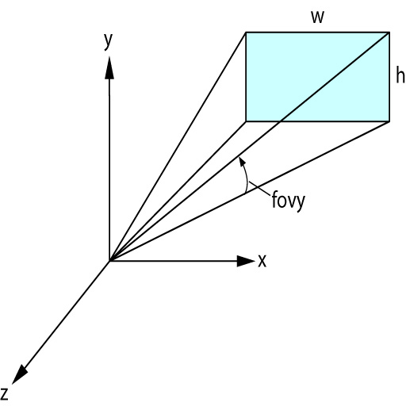
An Alternative Perspective
projMatrix = perspective
(fovy, aspect, near, far)
fovy = field of view on Y axis, measured in degrees
aspect = aspect ratio, usually 1
near, far = same as frustrum

